Slide 1
1.DC Motor First Principle
GODAVARTHI AAHLADH 2018HT01513

Slide 2

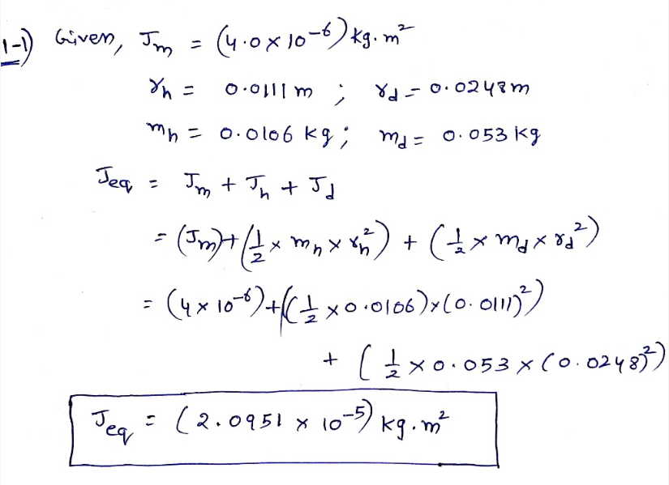
1-1. Equivalent moment of Inertia

Slide 3
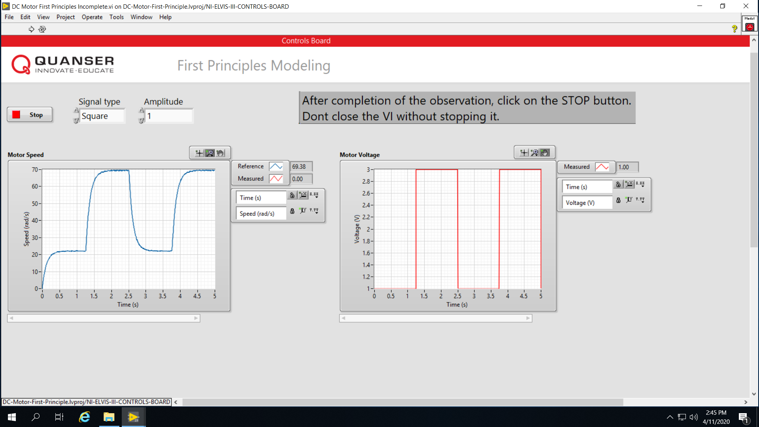
1-2 Attach the screen capture you saved in Step 4.

Slide 4
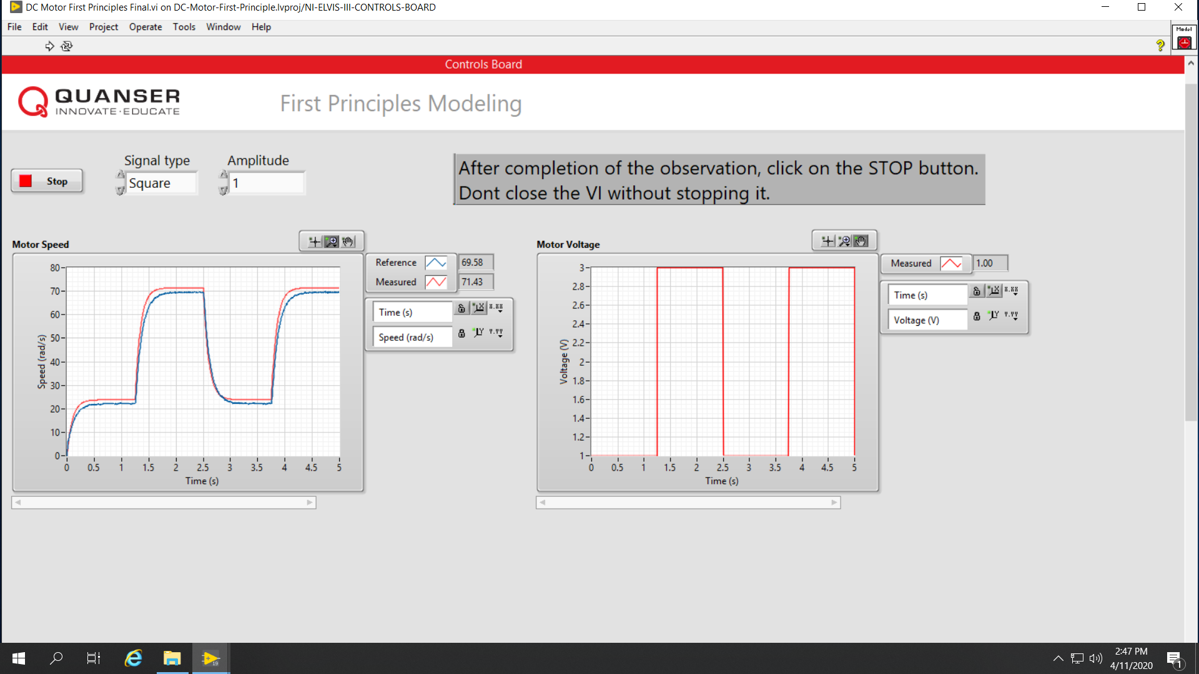
1-2 Contd.. (comparing actual with model)

Slide 5
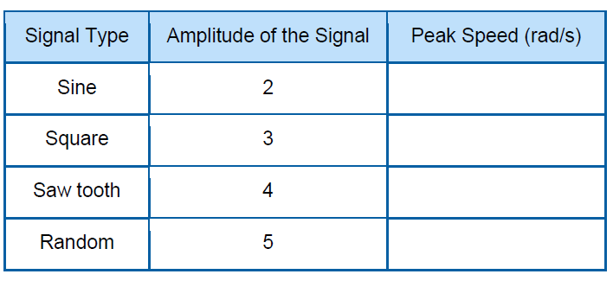
1.2.1
93.88
120
120.8
82.45

Slide 6
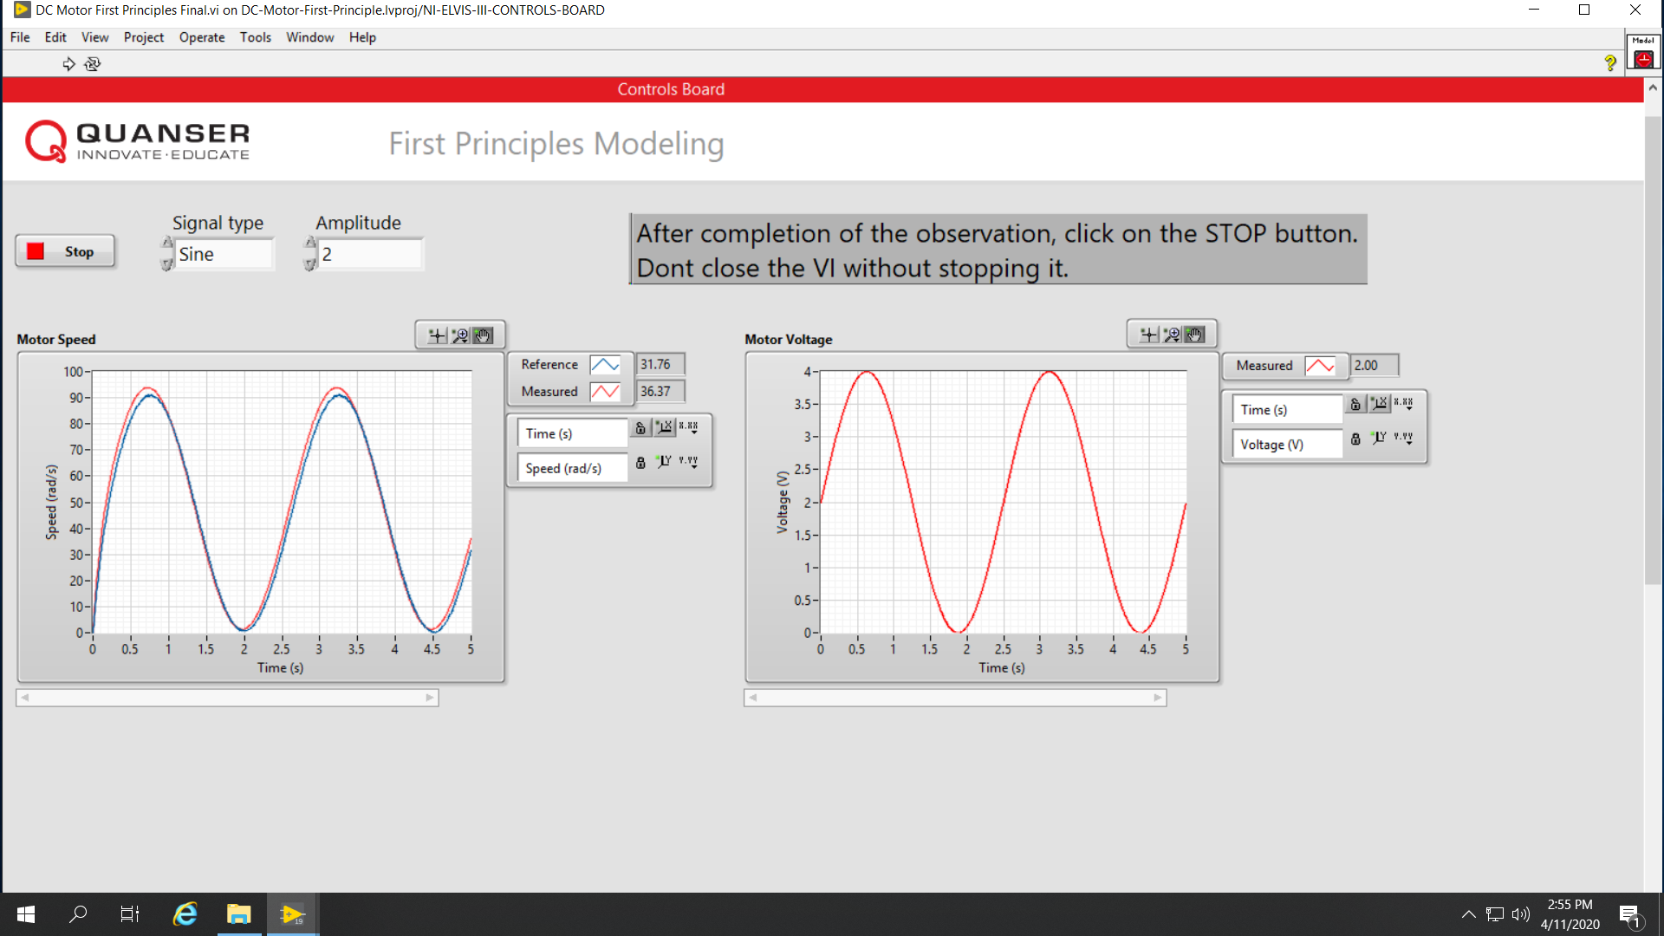
1.2.2 Sine with amplitude 2

Slide 7
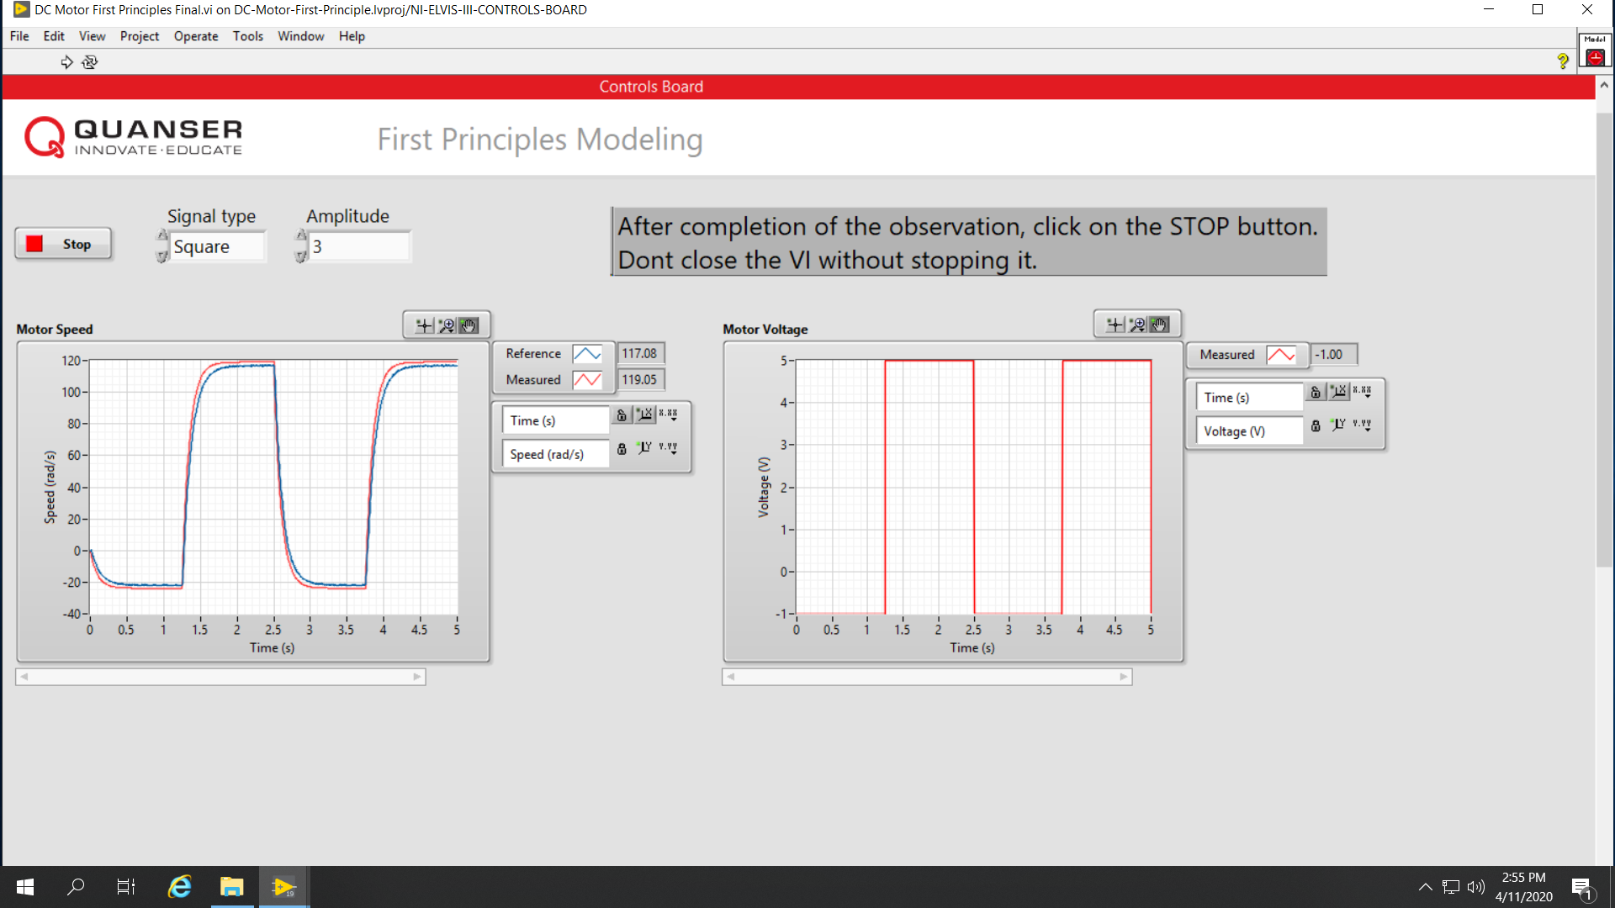
1.2.2 Square with amplitude 3

Slide 8
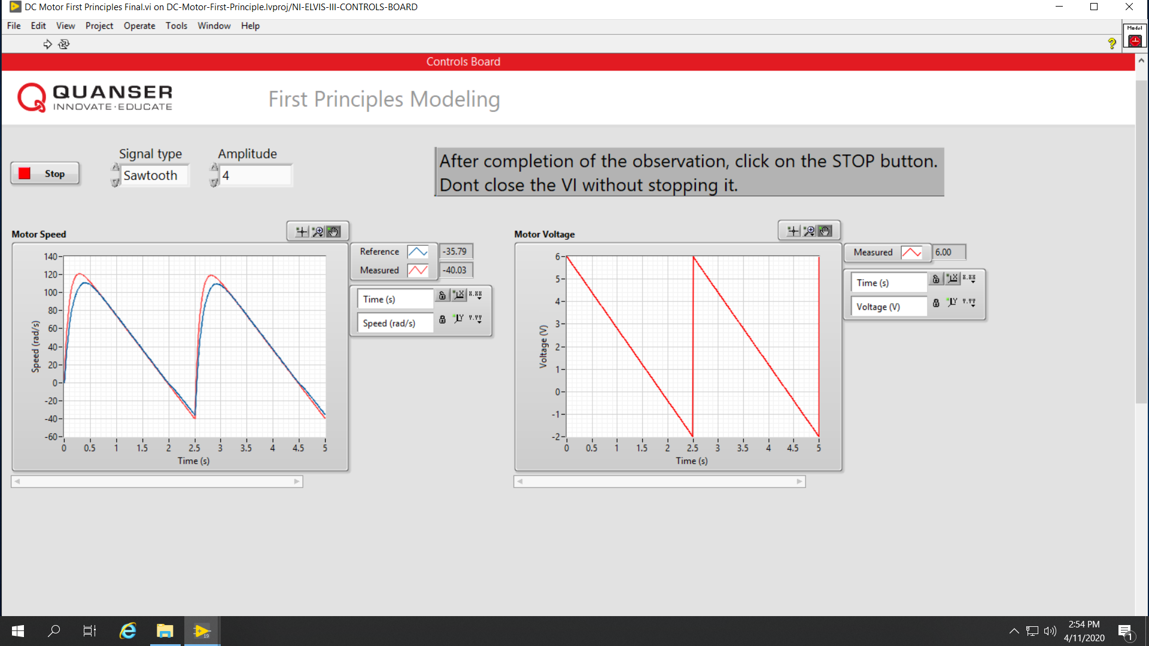
1.2.2 Sawtooth with amplitude 4

Slide 9
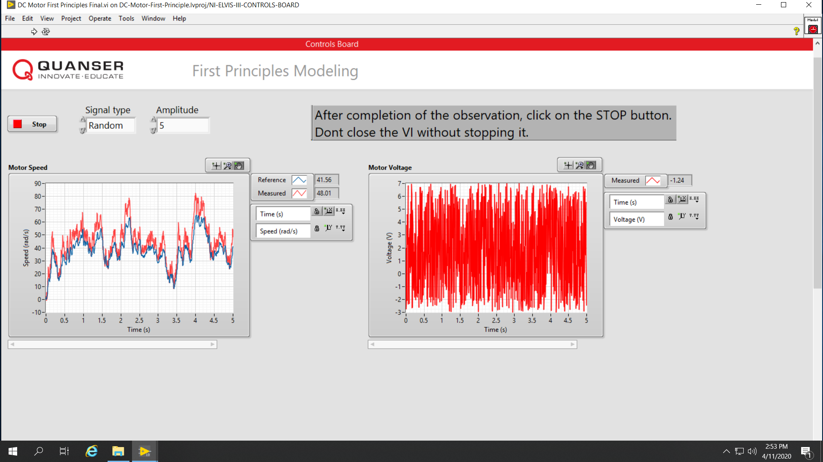
1.2.2 Random signal with amplitude 5

Slide 10
1.3 What is the offset voltage of the system after running the final VI (step 6)?
OFFSET VOLATGE = 1V

Slide 11
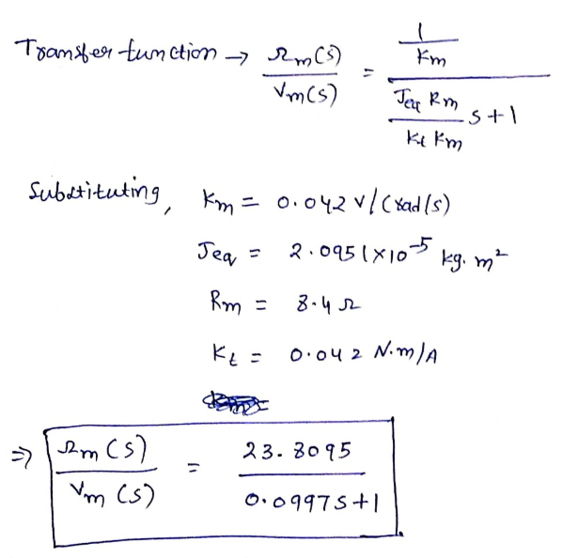
1-4 Transfer Function parameters

Slide 12
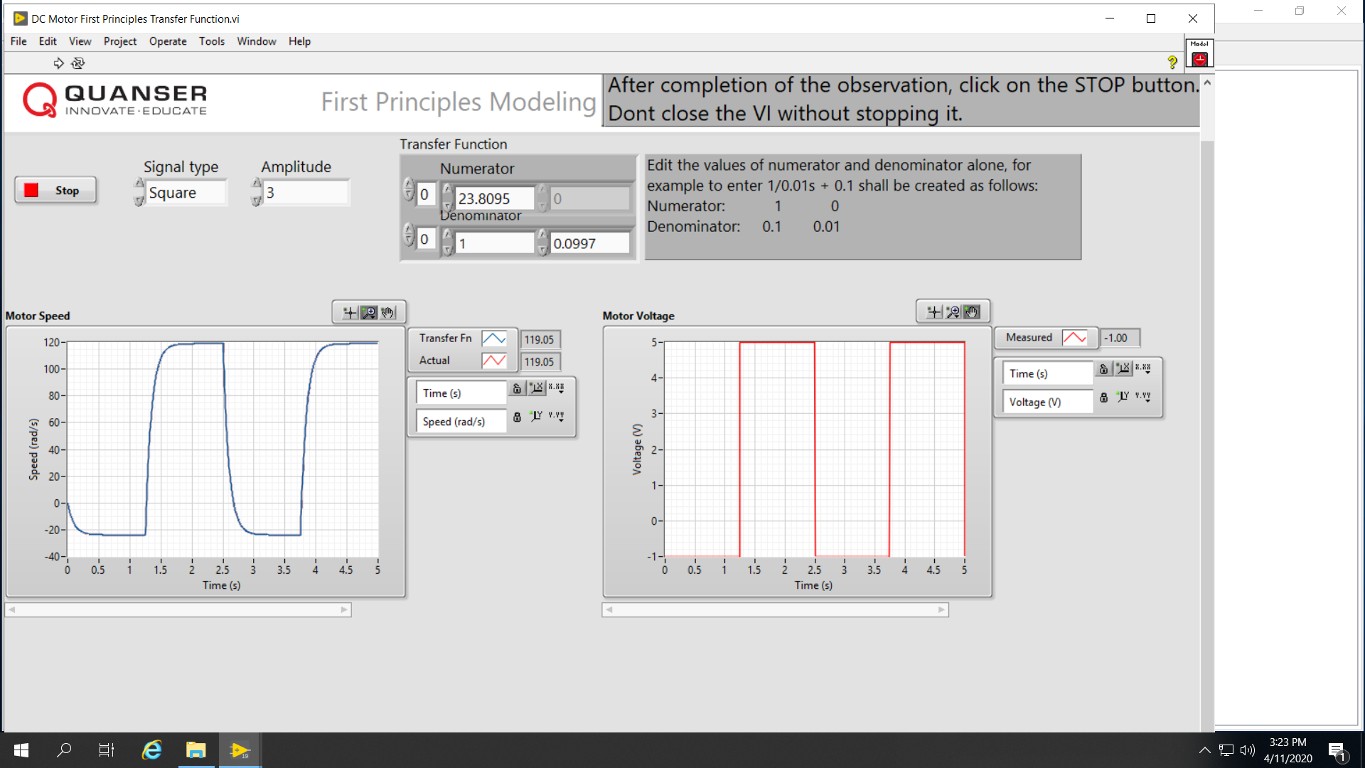
Note : Transfer function output exactly coincided with actual value. Hence red waveform is not visible.

